Slide 1
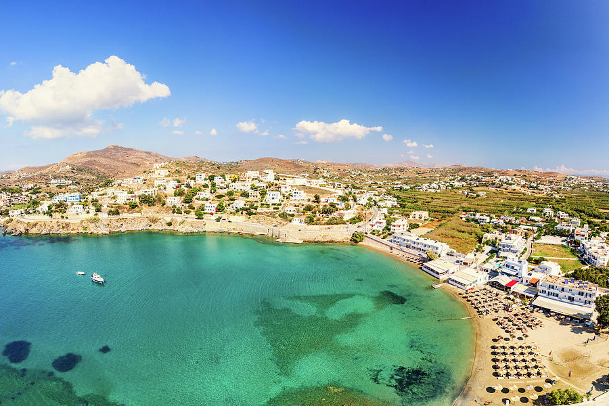
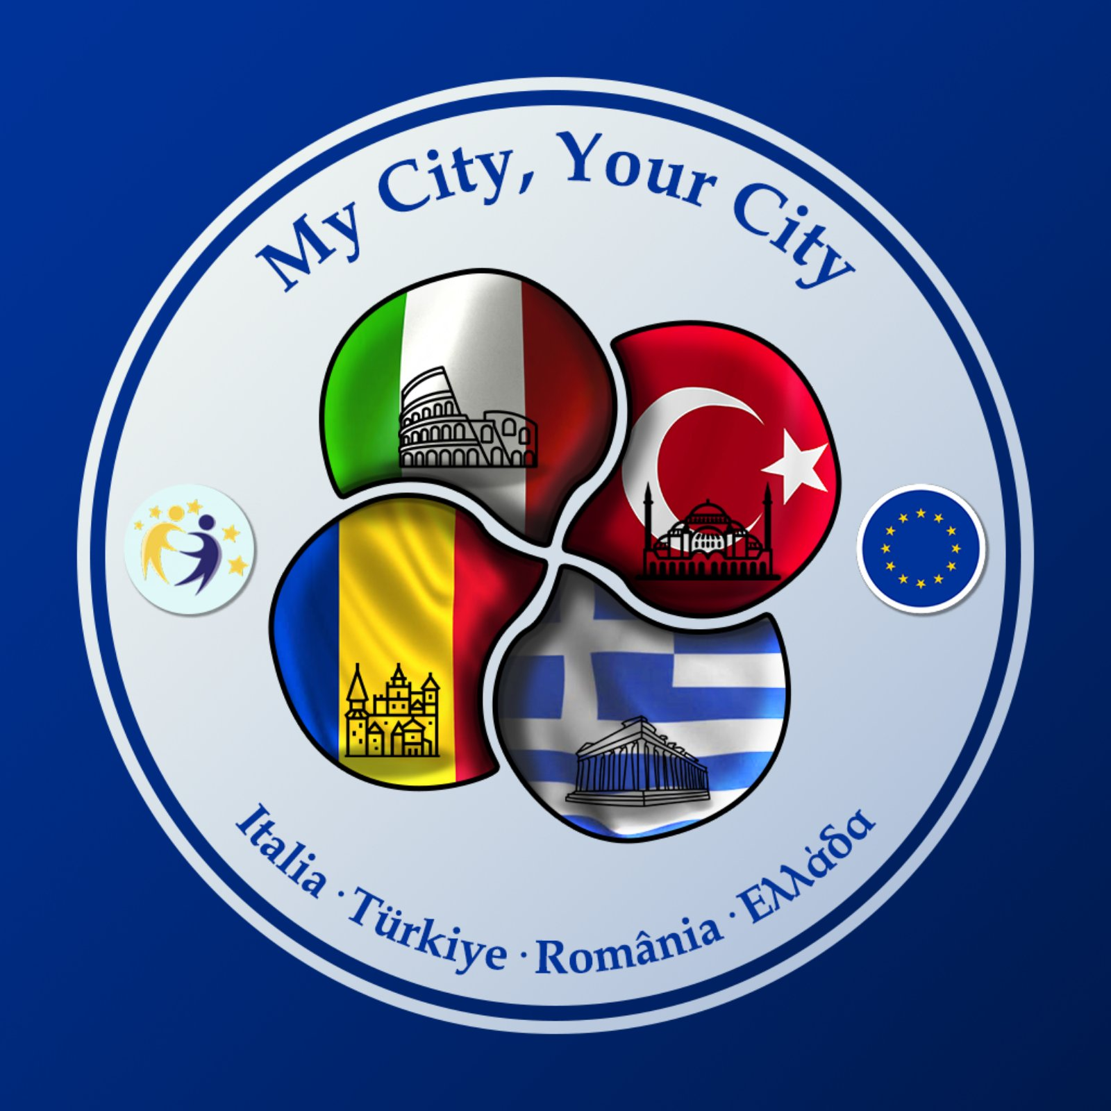

OUR CITY
VARI

Slide 2
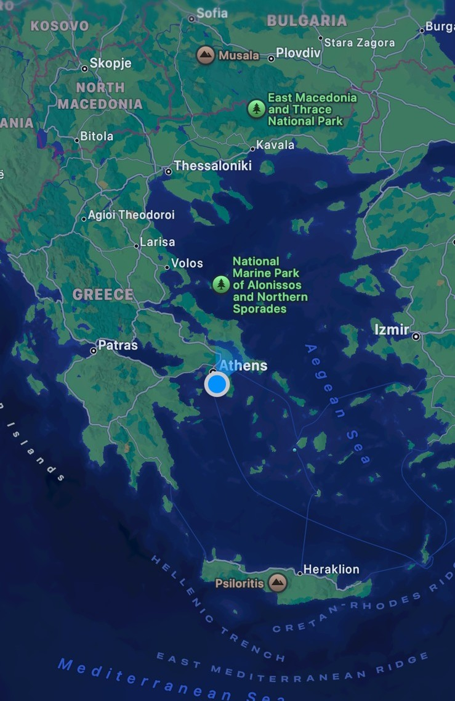
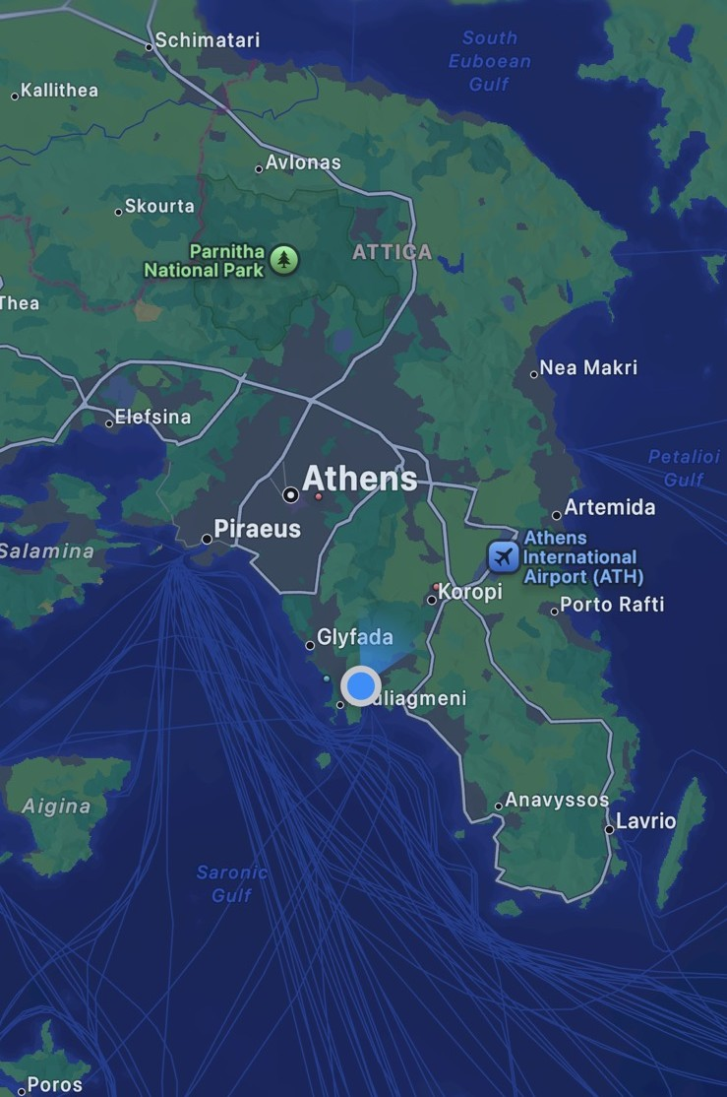
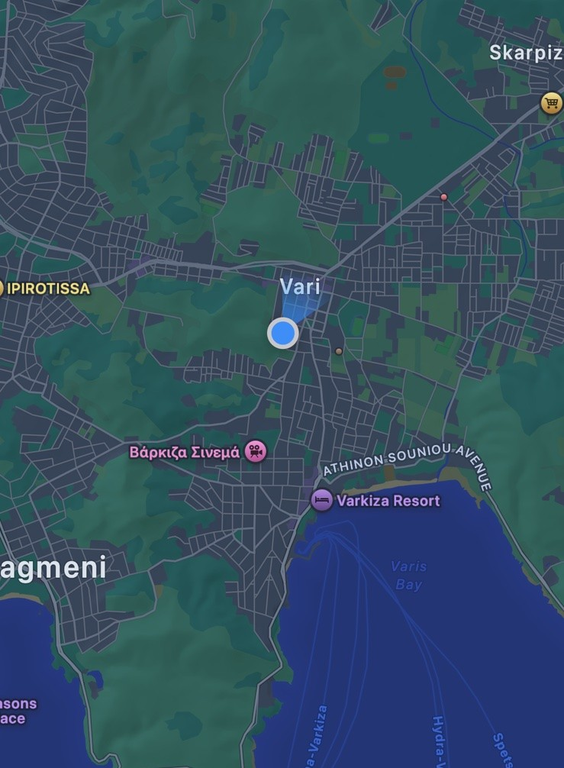
Greece
Athens
Vari

Slide 3
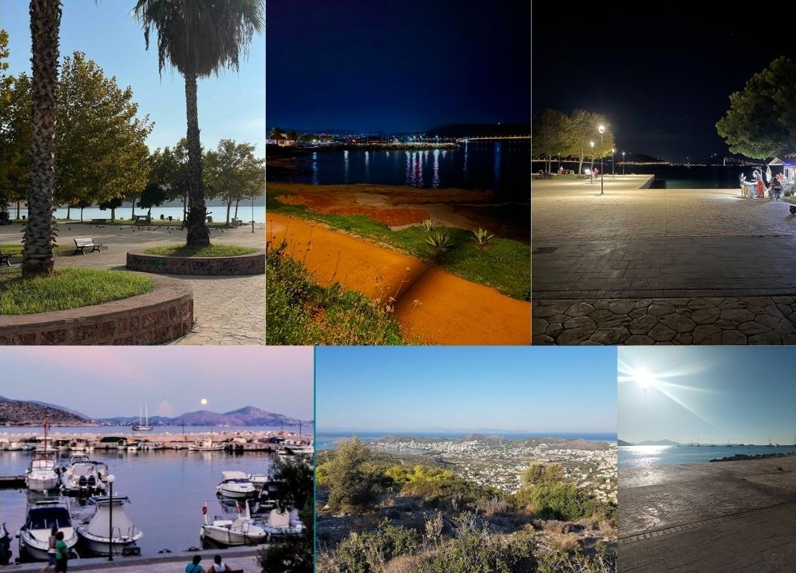
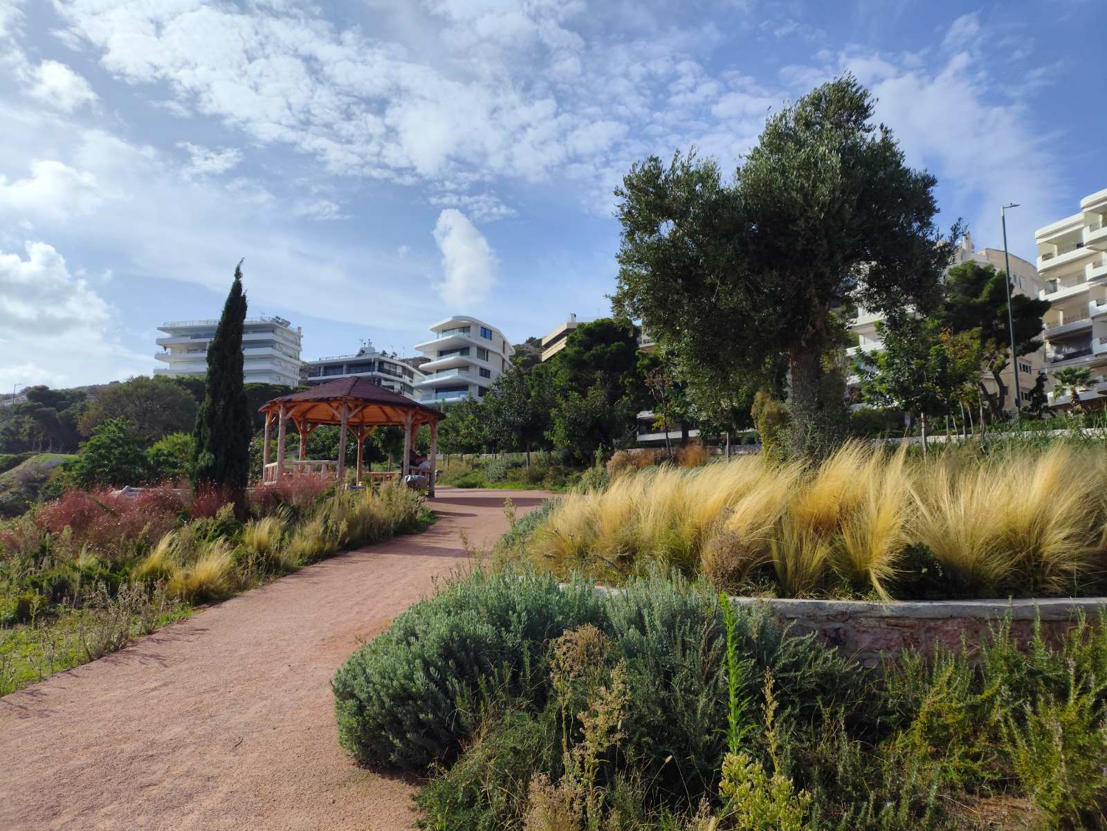
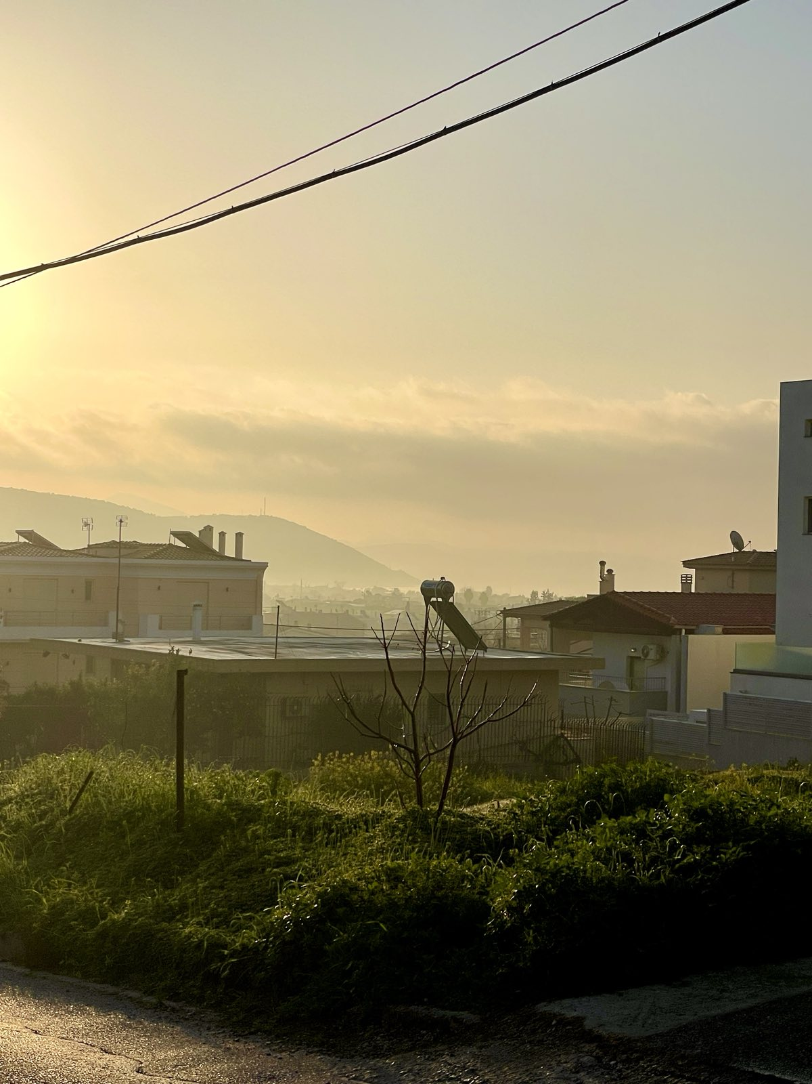
Vari is a coastal suburb and former municipality in southern Athens, now part of the Vari-Voula-Vouliagmeni municipality. Located between the Mesogeia plain, Mount Hymettus, and the Saronic Gulf, it includes Varkiza’s Blue Flag beach and is connected to central Athens by National Road 91. The area is historically significant, highlighted by a 2,000-year-old marble engraving that may depict an early temple on the Acropolis, indicating deep ancient roots.

Slide 4
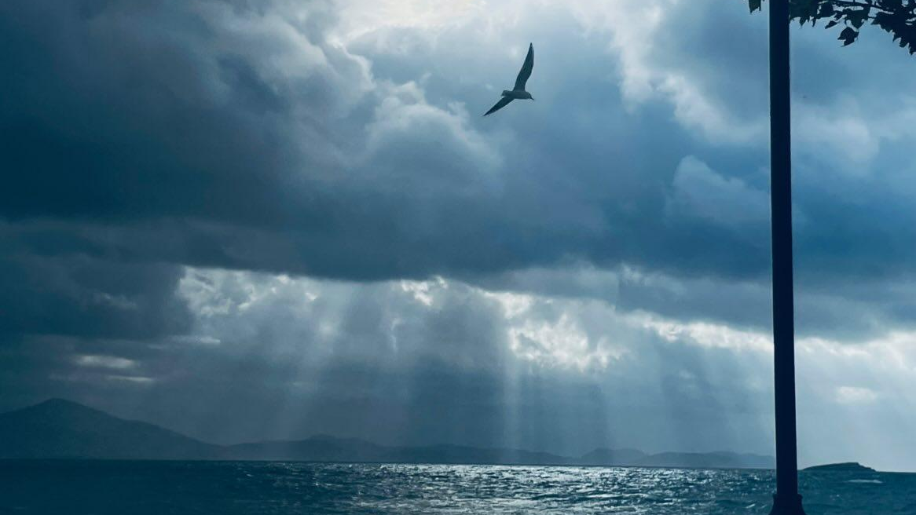
OUR History
Photo by : Georgia

Slide 5
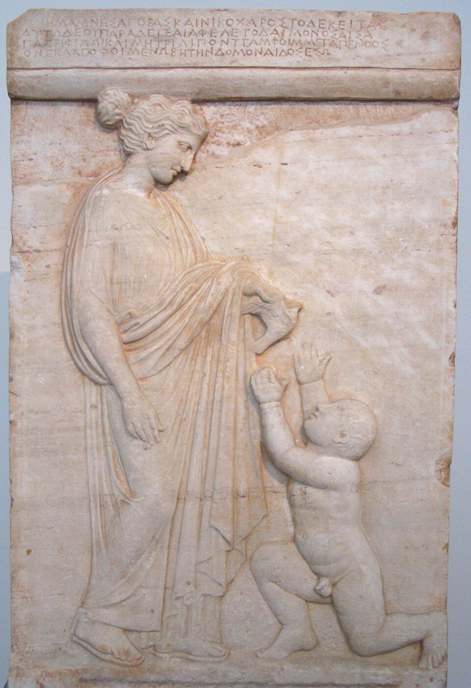
Vari is a suburb in southern Athens with a history that reaches back to the earliest foundations of ancient Attica. In antiquity, the area formed the center of the deme of Anargyrous, one of the first political and social communities created during the reforms of Cleisthenes in the 6th century BCE. Archaeological discoveries—such as carved tombs, rural houses, inscriptions, and ancient roads—show that Vari was an active settlement where people lived, worked, and practiced their religious traditions. Today, Vari brings together its long past with a modern, growing community, making it a suburb where history is still visible in the landscape.
Anargyrous

Slide 6
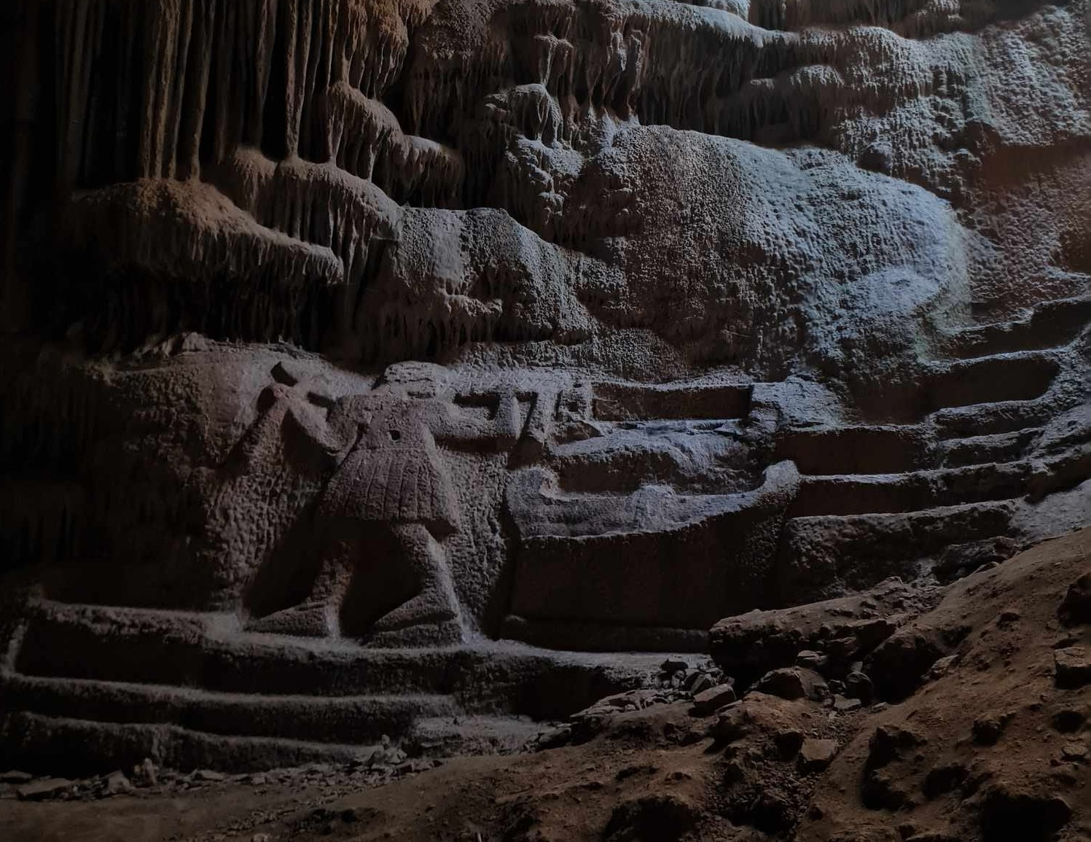
Near modern Vari lies the largely unexplored but historically significant ancient deme of Anargyrous, inhabited since at least the 3rd century BC and marked by remains of houses, cemeteries, sanctuaries, and the acropolis of Lathouriza—including the Cave of Nymphs and Pan, also known as the Nymphaion of Vari, a major sanctuary dedicated to the Nymphs and Apollo. These archaeological traces show that the area played an important role in the religious and everyday life of classical Athens, and even the modern name “Vari” reflects continuity with its ancient identity.
the Cave of Nymphs

Slide 7
Landmarks

Slide 8
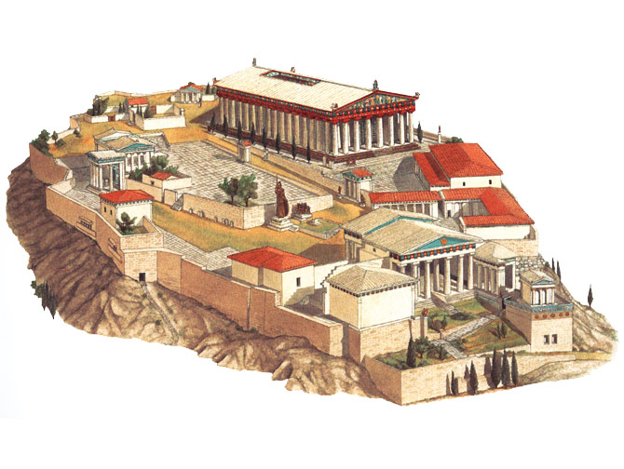
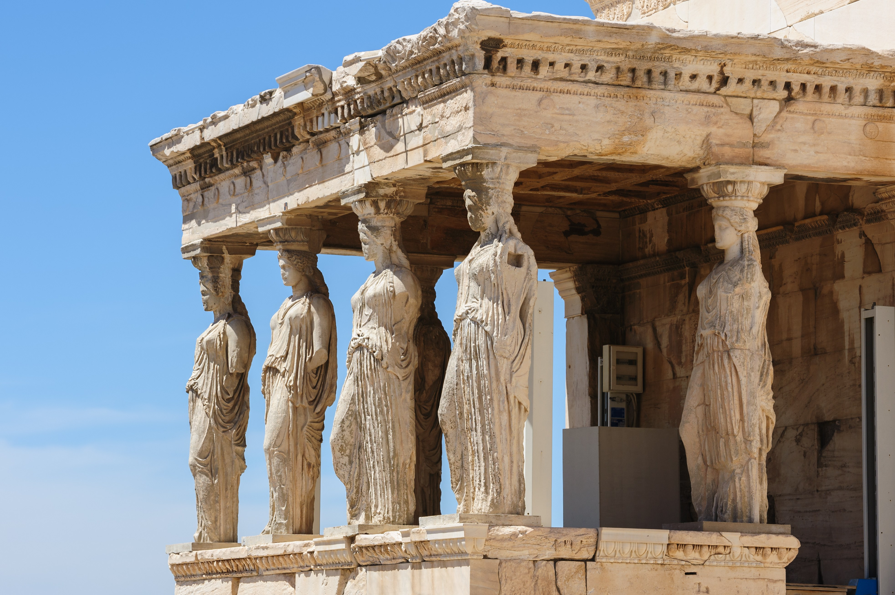
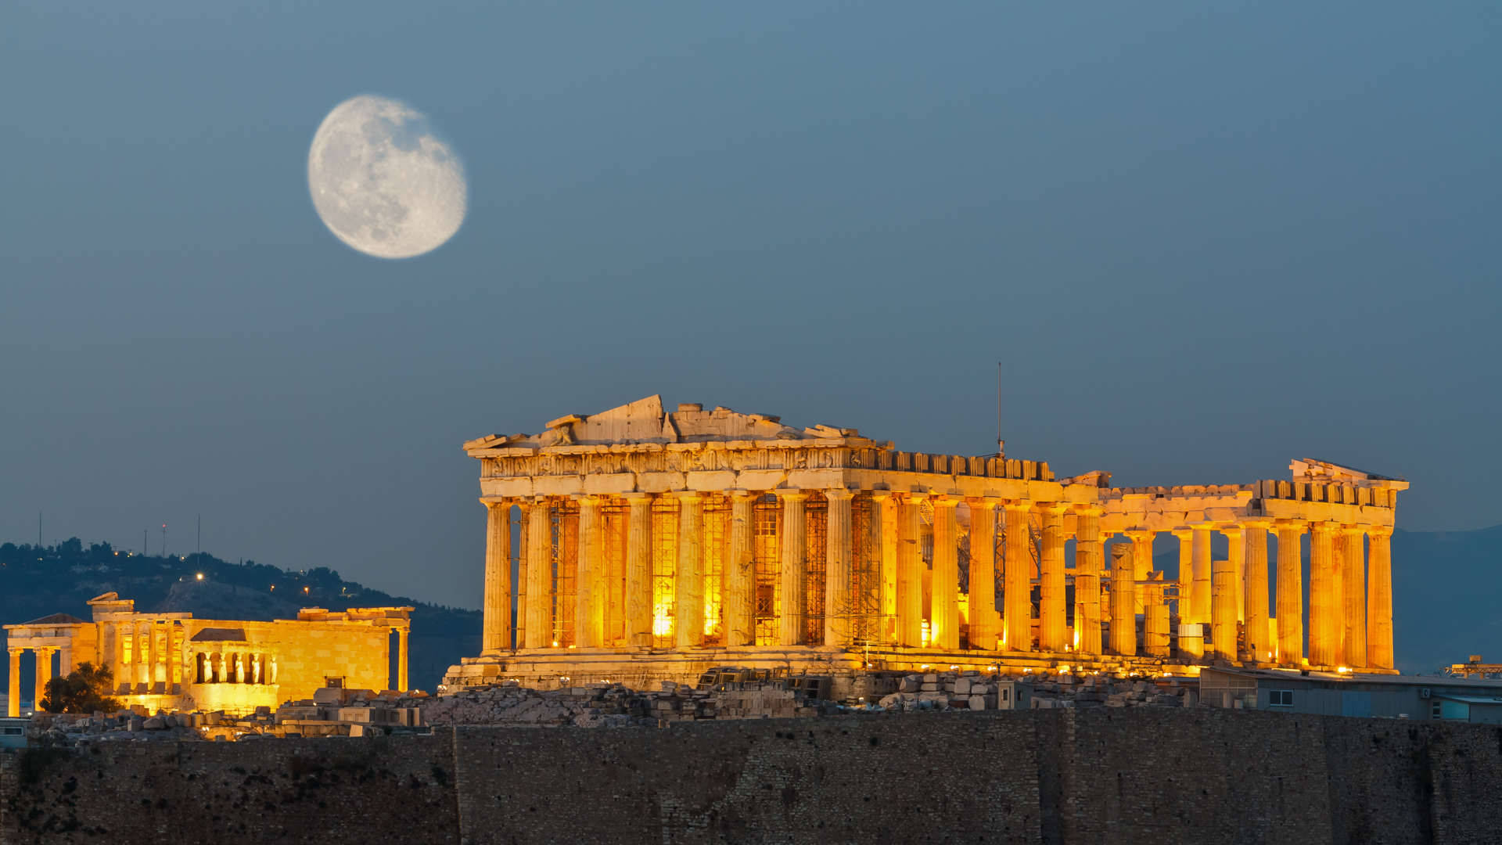
There are many landmarks of remarkable beauty throughout Greece, most of which are relics from the ancient times, in which Greece flourished. The most notable of these landmarks is of course the Acropolis of Athens. It is essentially the citadel of the city and contains the remains of multiple ancient buildings of historical and cultural significance such as the world famous Parthenon, a known symbol of Greece, the Erechtheion which is infamous for the Porch of the Maidens with caryatid columns and the Temple of Athena Nike (Victory).

Slide 9
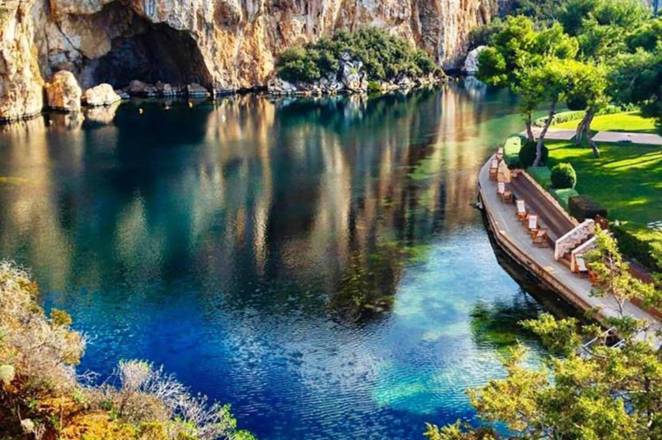
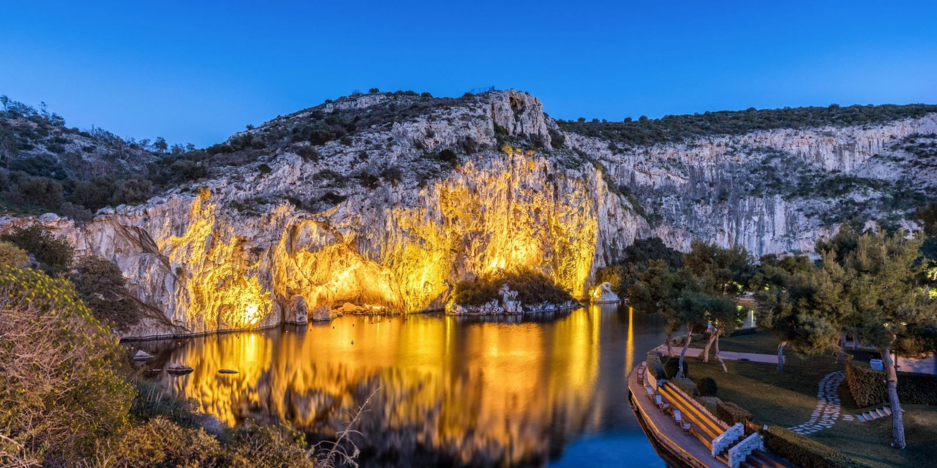
Another visit worthy landmark of Greece is the Vouliagmeni Lake which happens to be situated fairly near our school as those two belong in the same municipality. Lake Vouliagmeni formed about two millennia ago due to the collapse of a huge cavern caused by an earthquake. The lake is connected to an underwater cave that has never been fully explored as, even with sonar detection, tracing its end seems like an impossible task and many divers have actually lost their lives attempting to trace it. Today it serves as a notable landmark of Attica and due to its rich content in hydrogen sulphide it also serves as a natural spa.

Slide 10
OUR CULTURE

Slide 11
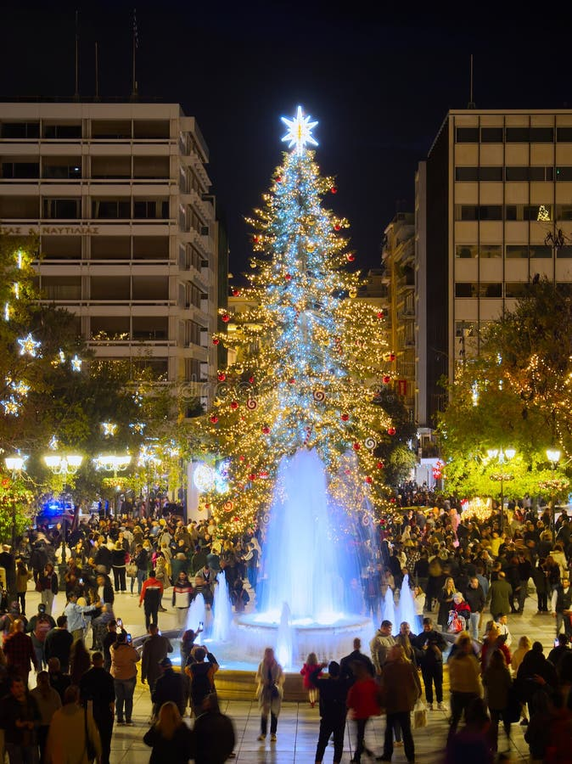
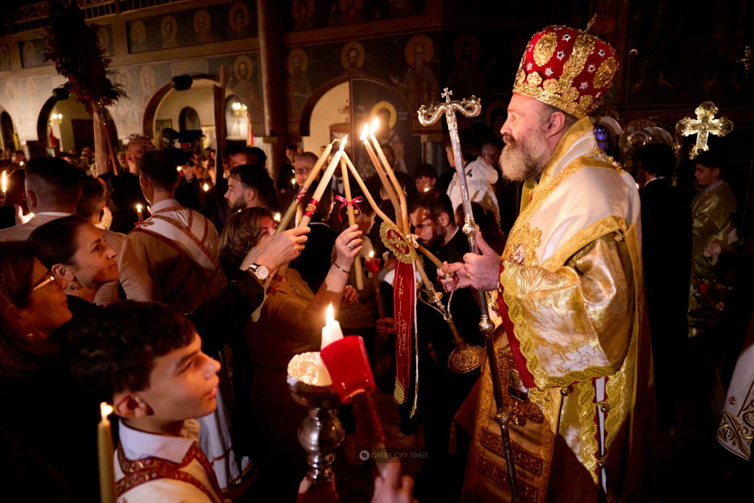
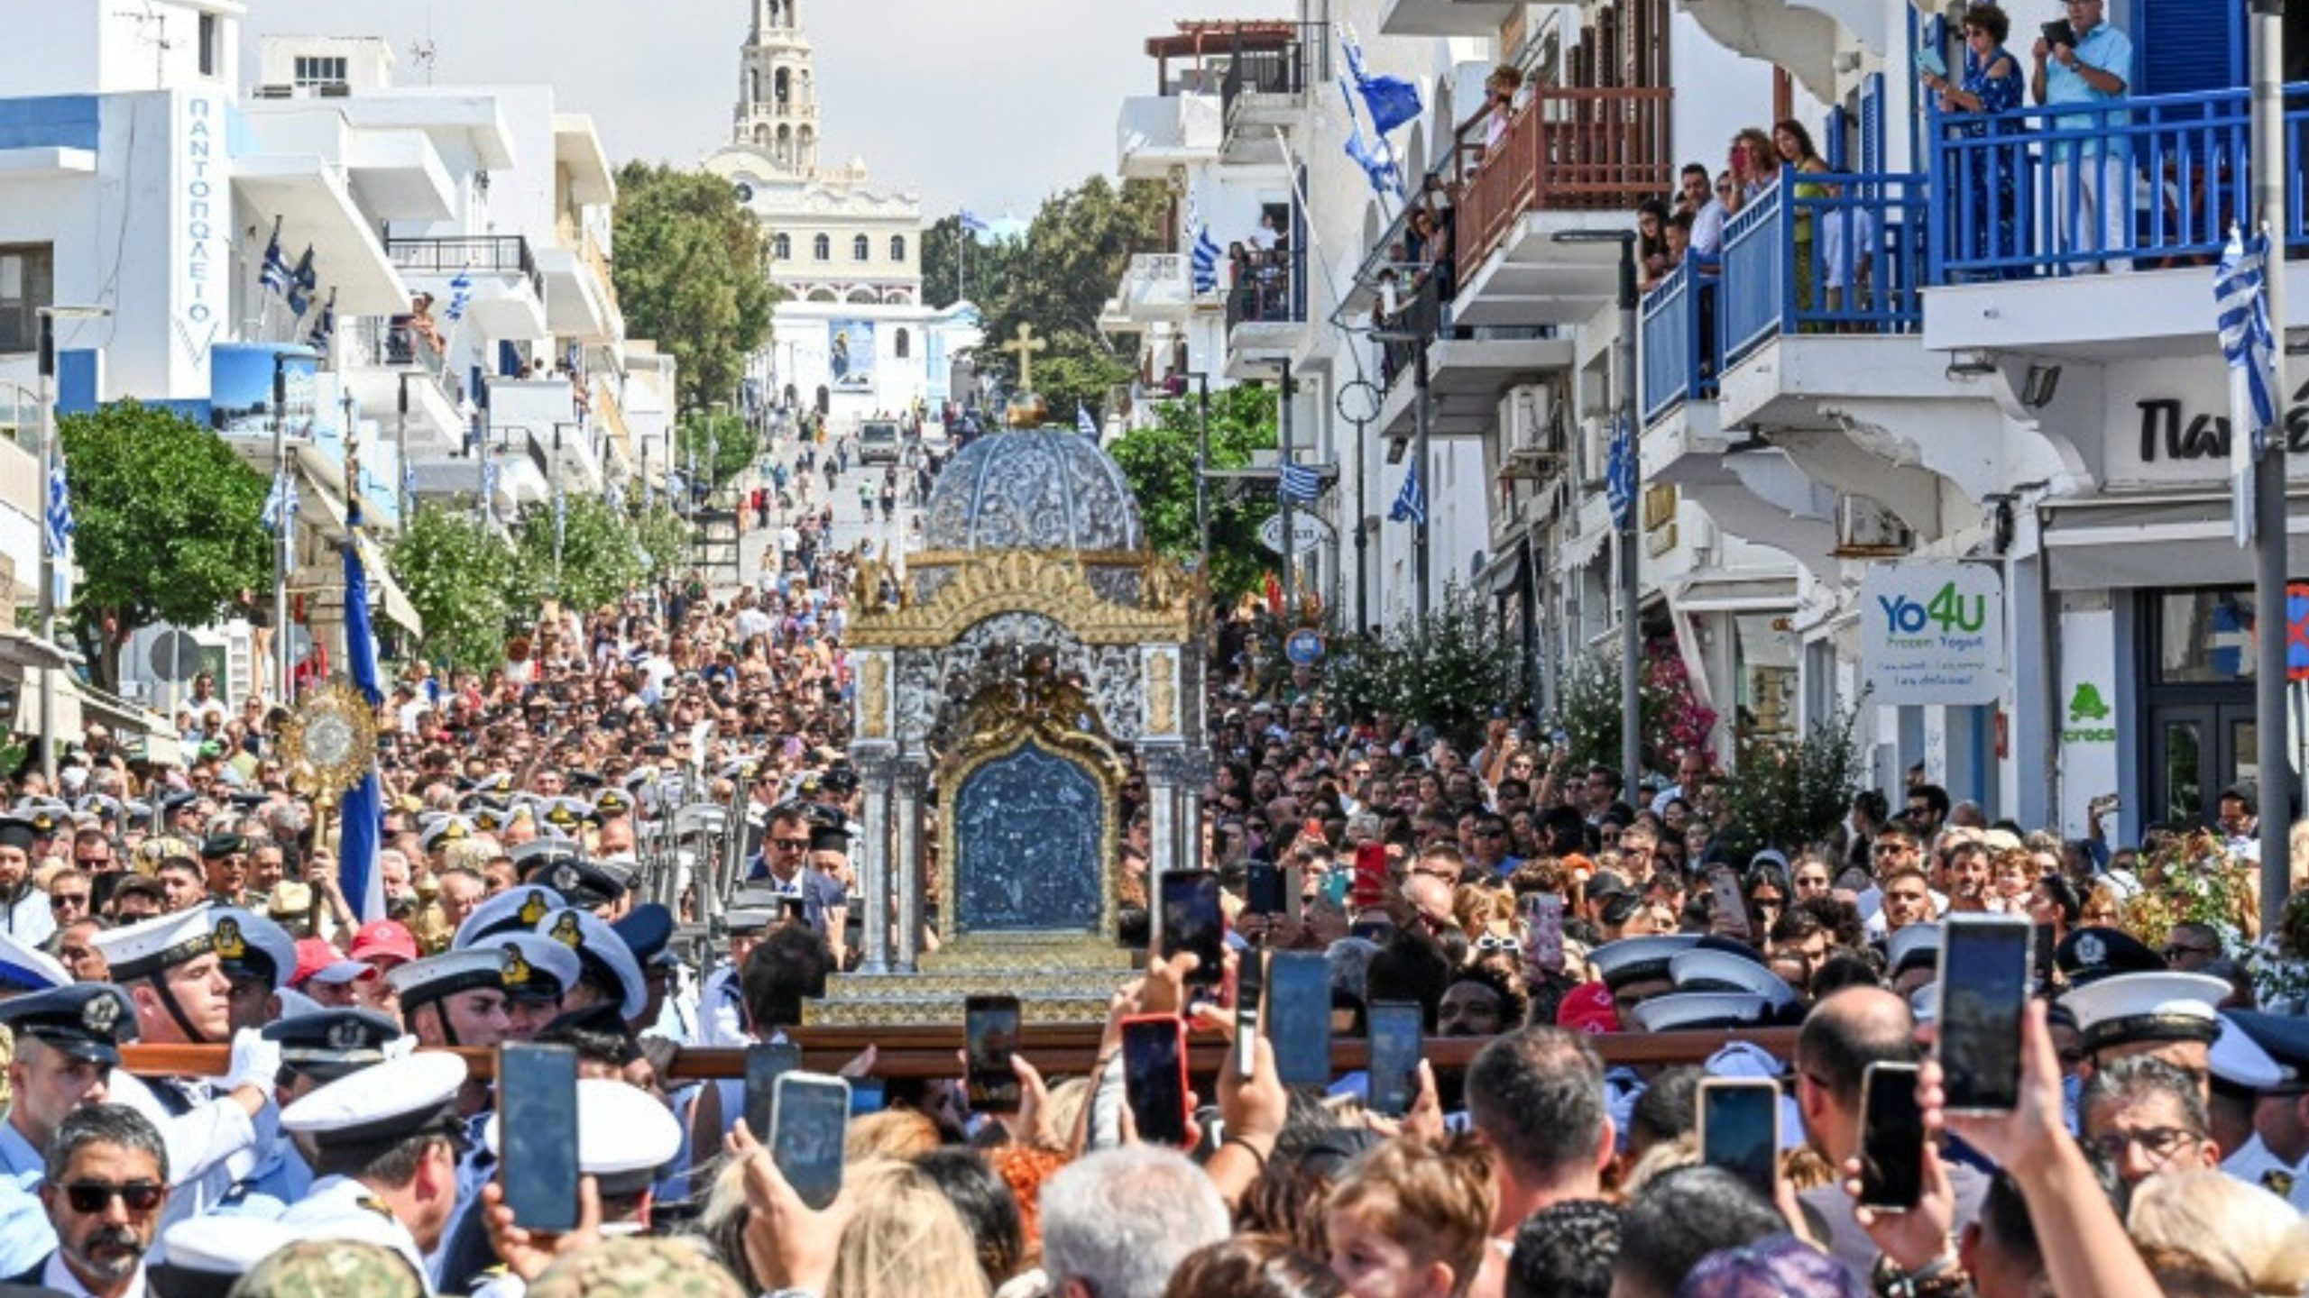
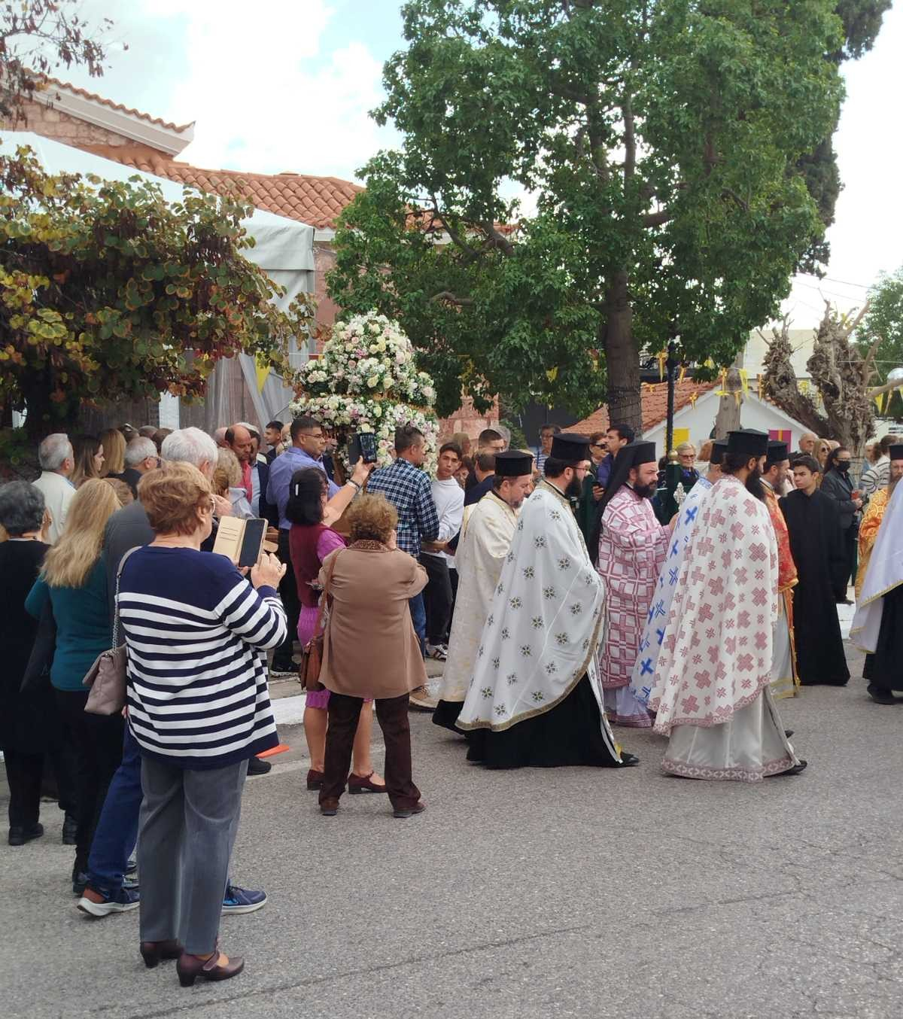
HOLIDAYS
The main holiday periods revolve around Christmas (25th of December), Easter (mobile celebration, usually in mid-April or May) and the Feast of Dormition of the Virgin (15th of August). Easter is the most important religious and family festival.
In Vari on November 21 we also celebrate with great honor and reverence “the income of the Virgin Mary” (when Virgin at the age of 3 walked with her parents on the Jerusalem temple, where she stayed).
Photo by : Anastasia

Slide 12
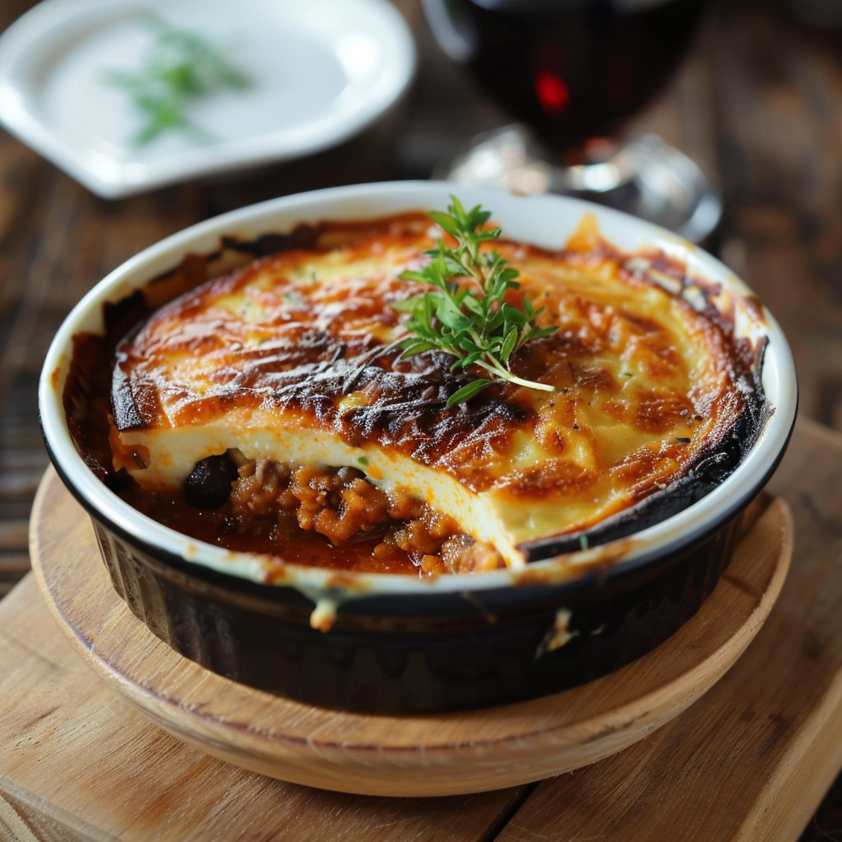
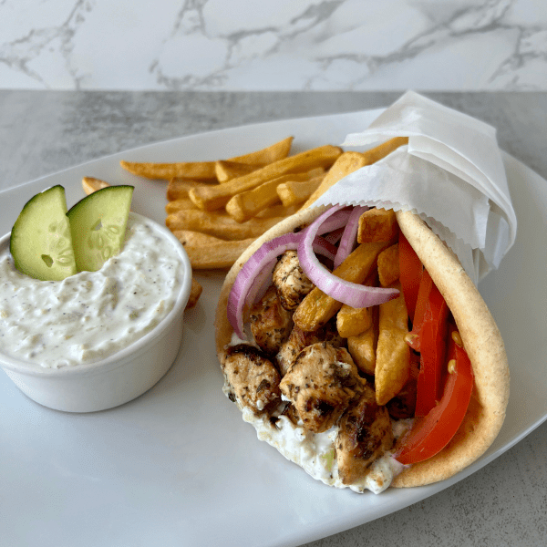
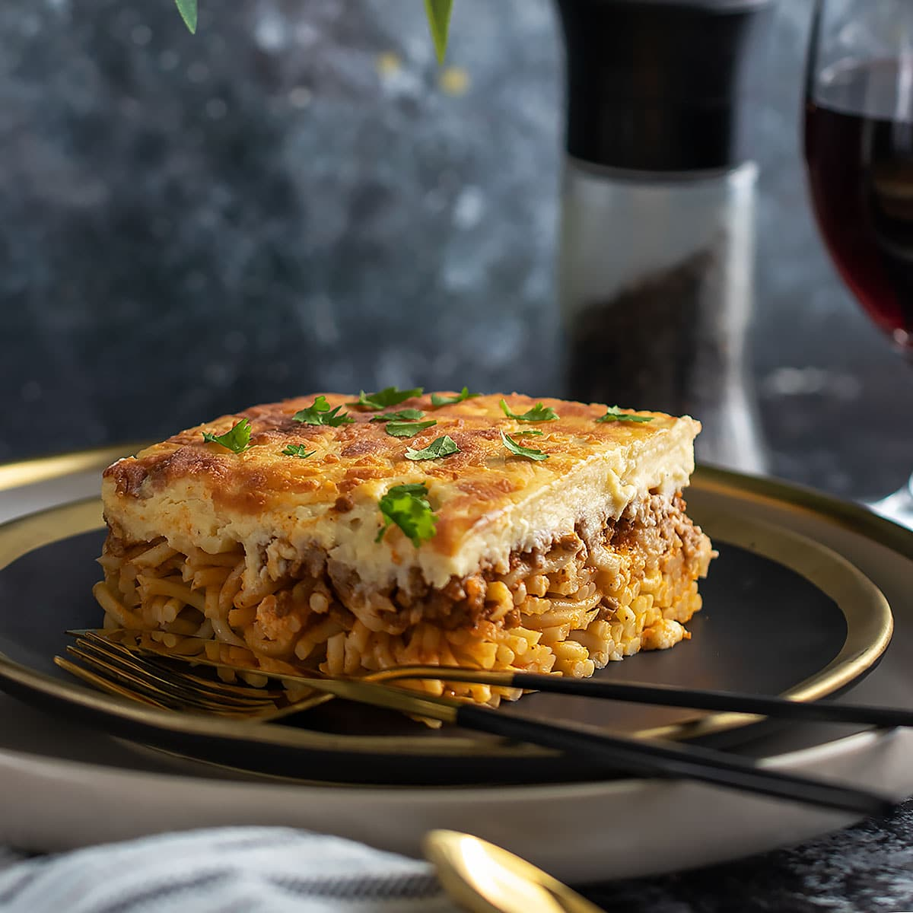
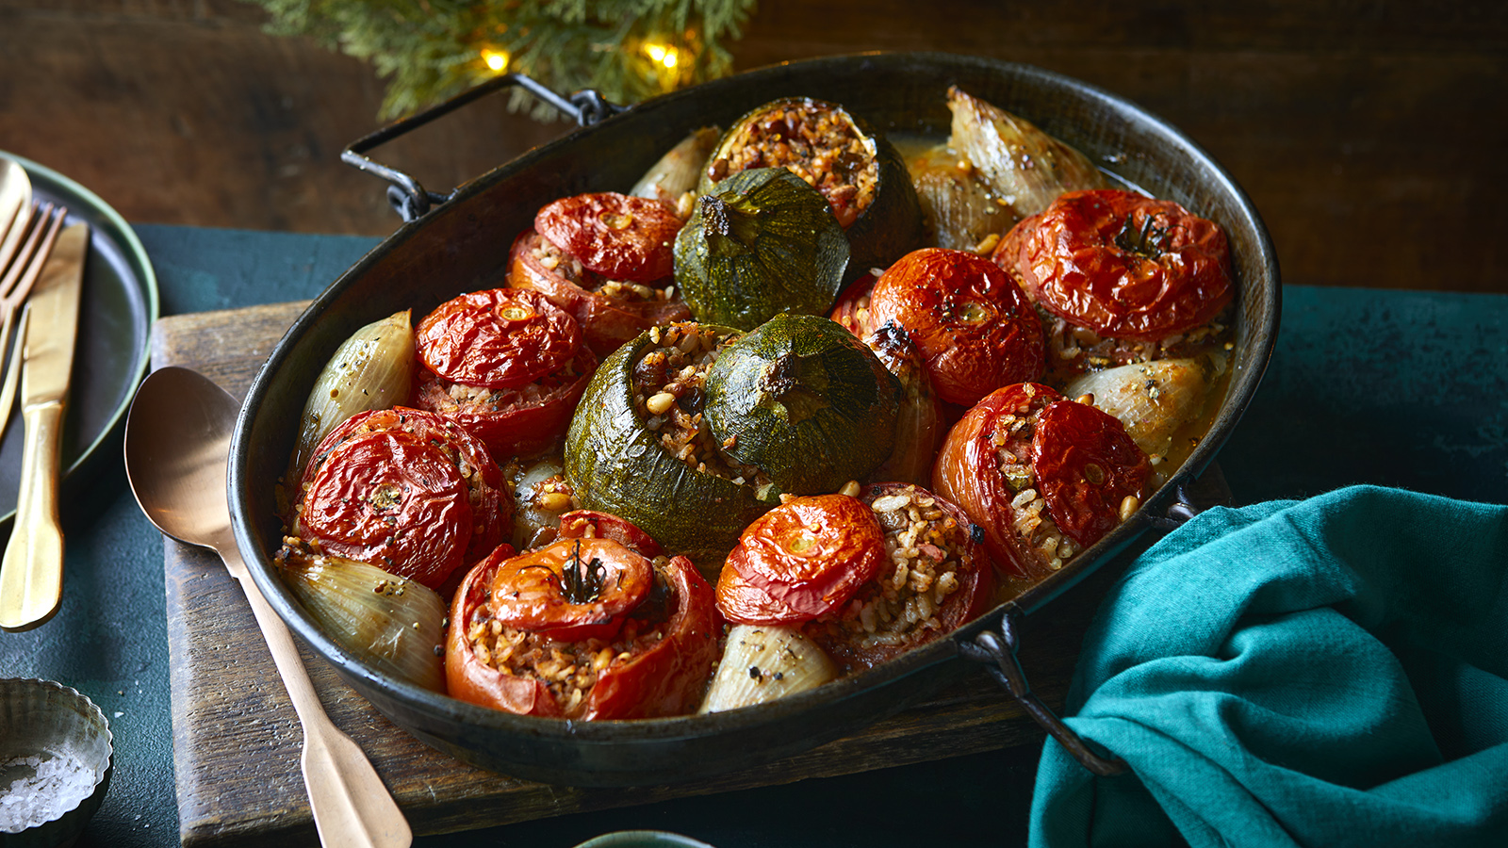
CUISiNE
The traditional Greek diet centered on plant foods, olive oil, cheese, bread, and seafood, with meat reserved for special occasions. As living standards rose, meat consumption increased, and modern fast food became common in cities.
Our most popular dishies:
Moussaka – Layers of eggplant, potatoes, minced meat, and béchamel sauce.
Souvlaki – Skewered grilled meat, often served in pita.
Pastitsio – Baked pasta with minced meat and béchamel, similar to Moussaka and Lasagna .
Gemista – Tomatoes or peppers stuffed with rice (sometimes meat).

Slide 13
ARTS
Greece has made its greatest contributions in the field of literature.
Two Greek poets have won the Nobel Prize for Literature: George Seferis in 1963 and Odysseus Elytis in 1979. The novelist best known outside Greece is the Cretan Níkos Kazantzákis.
A number of Greek composers have acquired an international reputation, including Nikos Skalkottas, Manos Hadjidakis, and Mikis Theodorakis.
Well-known Greek painters and sculptors include Nicolas Ghika, Yannis Tsarouchis and Yannis Moralis.
The traditional shadow puppet theatre, Karaghiozis, is now largely extinct, having been displaced by modern forms of entertainment.
Greece is a huge archaeological site! Every corner is filled with archeological ruins and every place has its own history.

Slide 14
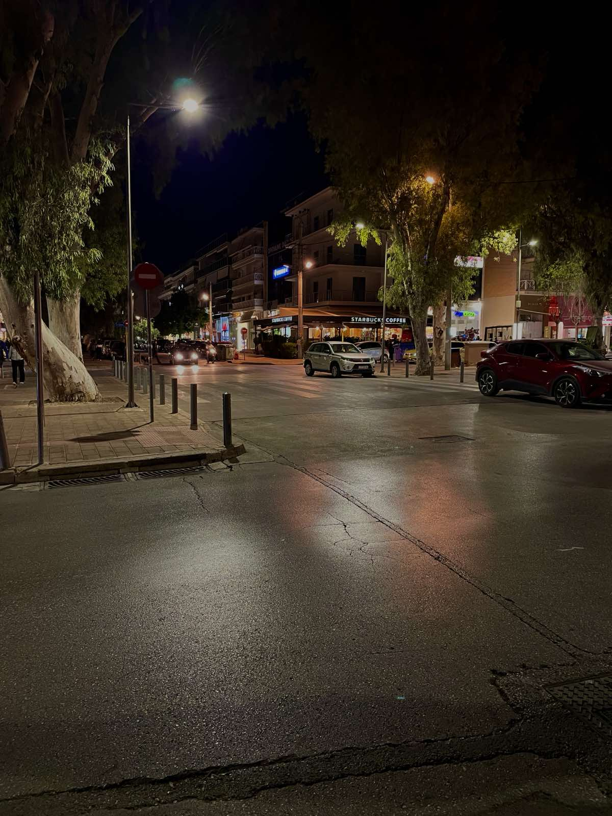
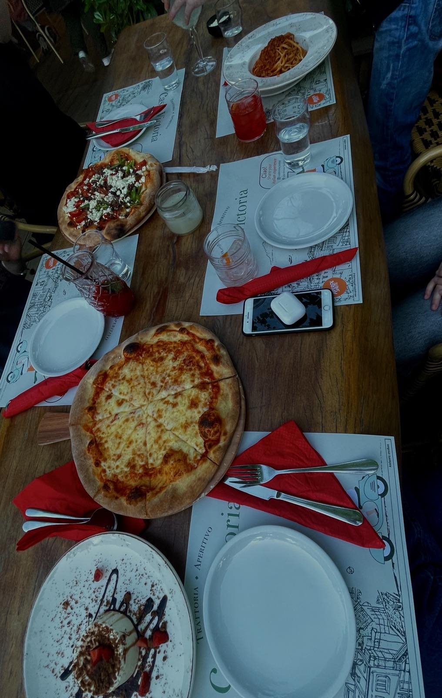
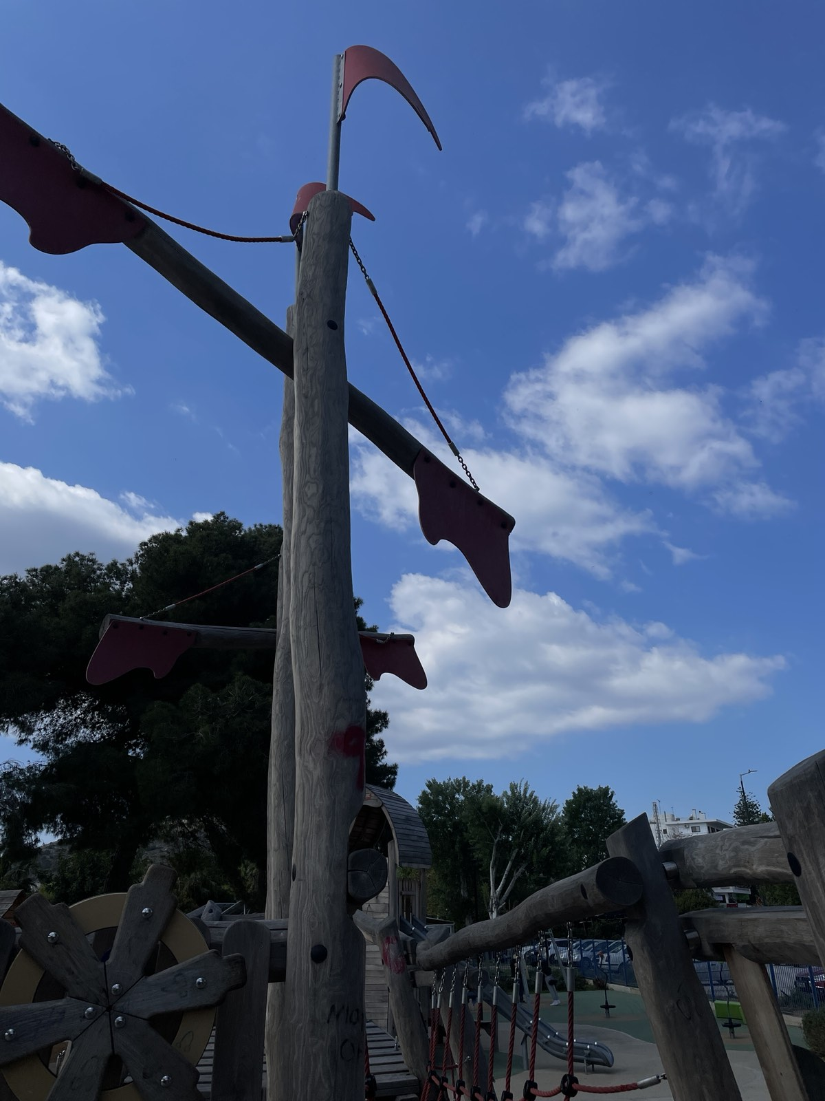
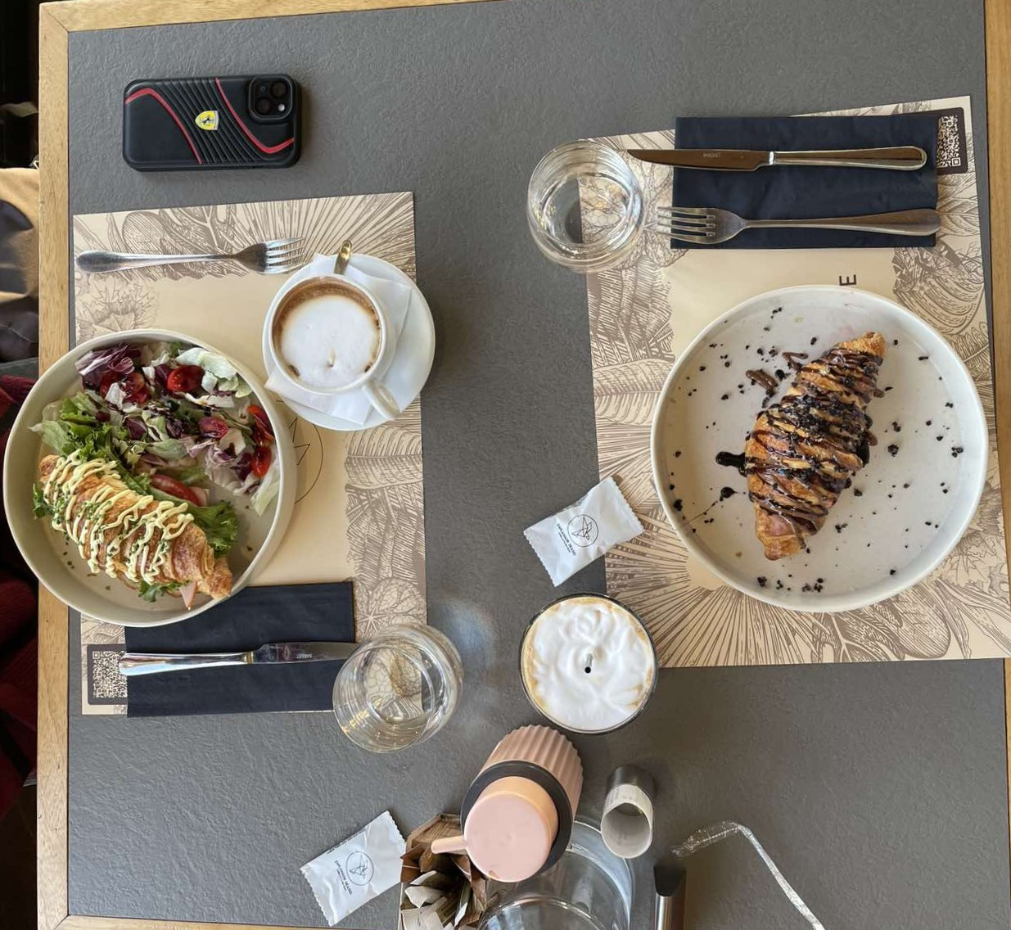
SOCIAL LIFE
Greek society is noted for its strong family structure. In the hot summers, social life in Greece tends to be outdoors. In summer and winter much leisure time is passed in the numerous cafés and coffee shops. Television, the Internet, and forms of video entertainment have to some extent undermined these traditional leisure patterns.
In Vari, children and teenagers hang out at parks and cafes. Adults and adolescences prefer to stroll up and down along the shore and the port. There are plenty restaurants and bars where they can enjoy a cozy atmosphere with greate food quality and drinks.
Photos by : Lefteris

Slide 15
OUR ECONOMY

Slide 16
Municipal reorganization (2010)-> Vari was merged with Voula and Vouliagmeni under the Kallikratis reform (creating the Municipality of Vari-Voula-Vouliagmeni). That changed local budgets, planning and service responsibilities.
Pre-crisis (mid-2000s)-> relatively strong local economy & rising real-estate — the southern suburbs (Voula/Vari/Vouliagmeni) were already higher-income residential / holiday suburbs of southern Athens with above-average property values.
2009-2014-> The Greek debt crisis temporarily depressed local construction and demand, but this area has been among the quicker ones to recover.
As of 2024–2025-> Real-estate prices in the area rose strongly (around 7.9% in 2024), and forecasts point to further growth.

Slide 17
Our school

Slide 18
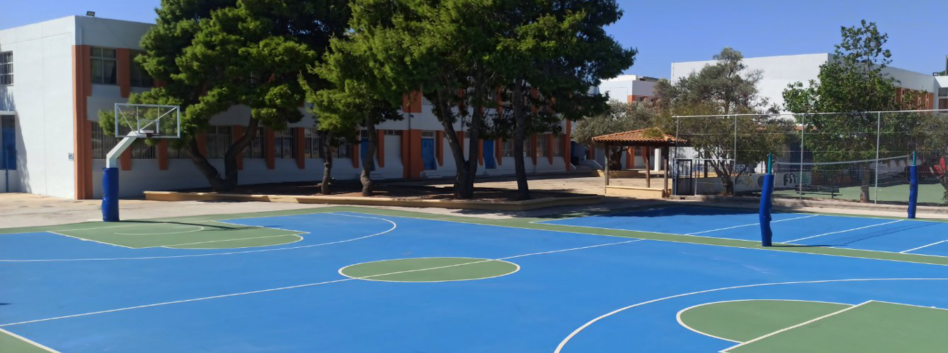
General information:
Our school is the only senior high school in our town - Vari. This year, 320 students study here. An interesting fact about our school is that it has been open for so long that many students’ grandparents used to study there!

Slide 19
Programmes
Apart from eTwinning, this year (2025-26) our school takes part in other programmes such as:
EPAS - a project conducted by the European Parliament.
Cultural programmes about:
Comparing aspects of Greece’s and Spain’s history, music or gastronomy.
Analysing cultural and financial relations of the Byzantine Empire and Venice.
Environmental programmes looking to sharpen the student’s perception about world-wide environmental issues and how they are linked to inequality.

Slide 20
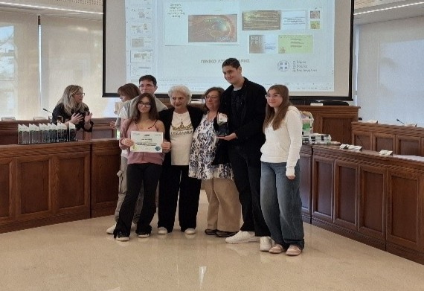
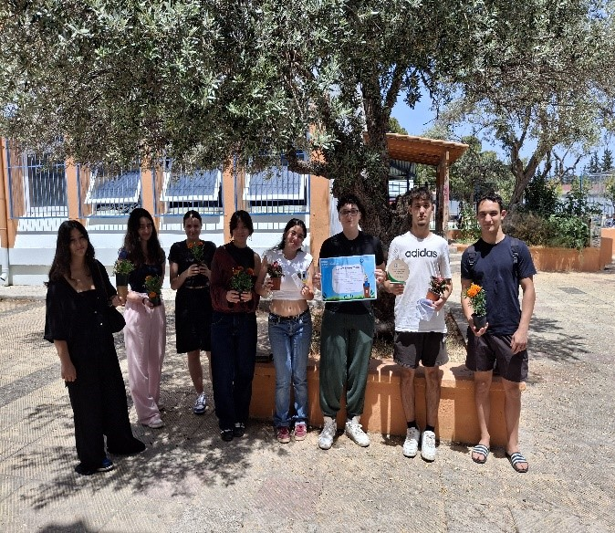
Awards
This October (2025), our school was awarded at the town hall for its participation in the programme “cycle economy” which is all about reducing waste by finding ways to reuse unwanted items.
In May (2025), our school conquered the 2nd place in a “contest” between our municipality’s schools about accumulating waste coming from food in order to compost it.

Slide 21
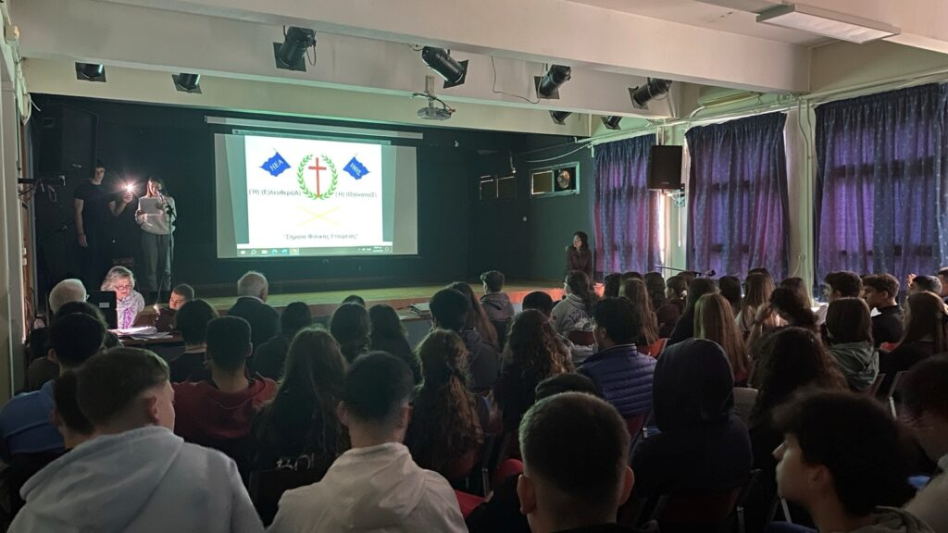
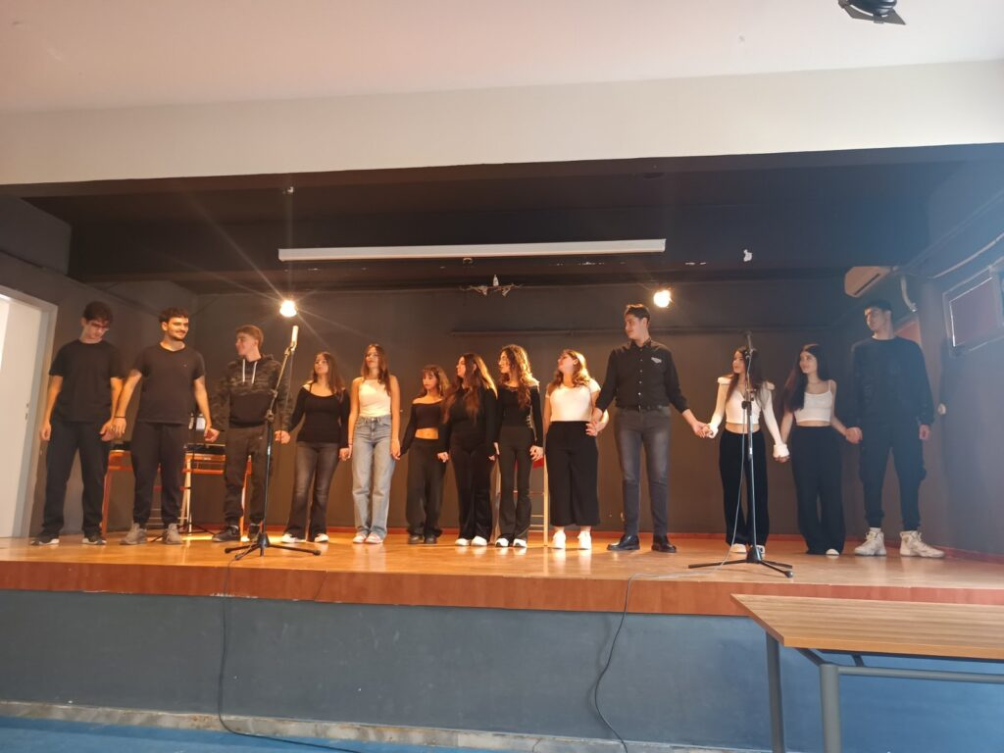
Celebrating national holidays
Our school always organises events for the national holidays which include theatrical plays and students playing musical instruments and singing.
March 25 - Greek Independence Day.
October 28 - “Ohi Day” (Anniversary of the No), the rejection of Greece to surrender to Italian forces during the 2nd World War.

Slide 22
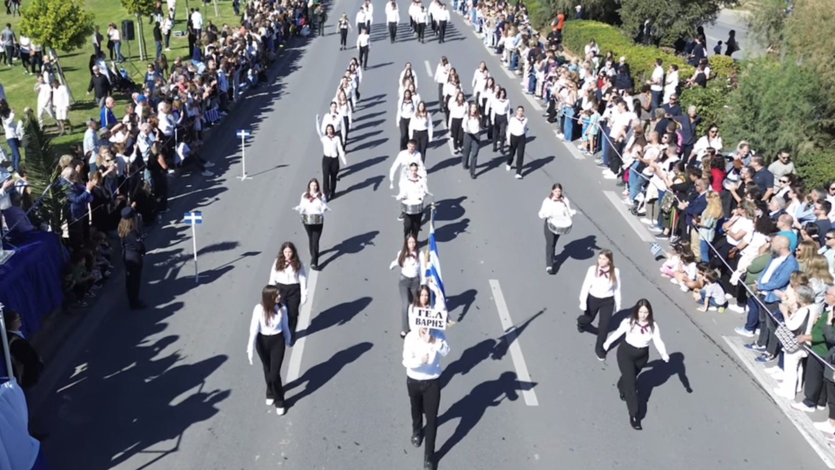
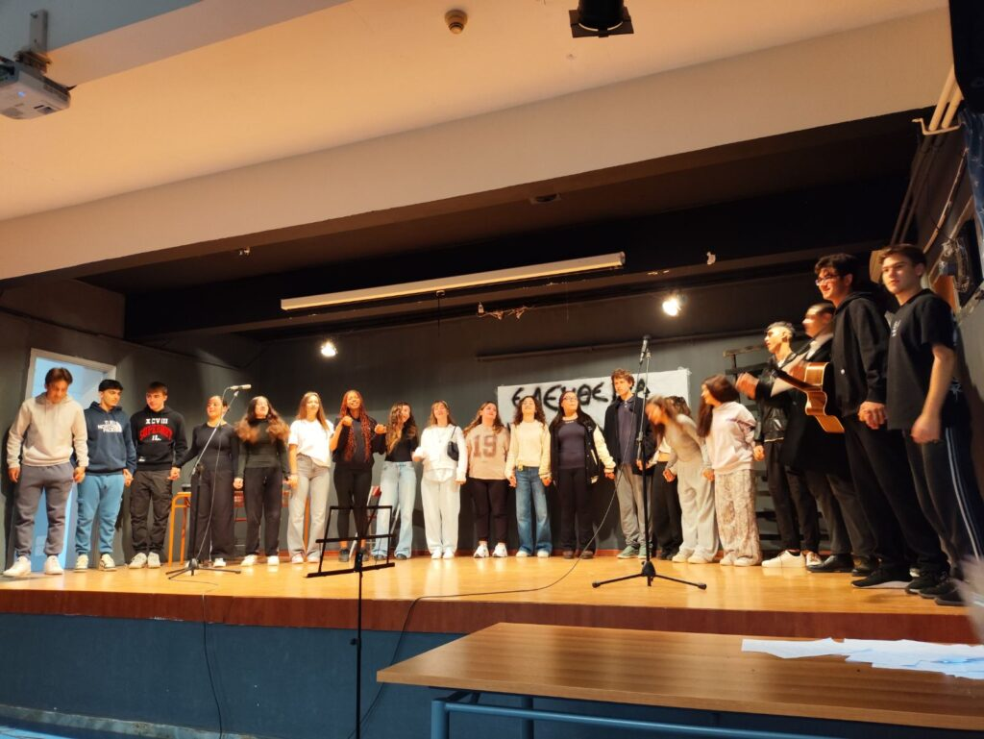
Celebrating national holidays
And of course, our school always takes part in the student’s parades organised every year on March 25 and October 28.
November 17 - The day a revolution started in the National Technical University of Athens which sparked the return of democracy in Greece after 7 years of dictatorship.

Slide 23
Thank you for watching

